Slide 1
Twitter Sentiment Analysis

Slide 2
Sentiment Analysis
Sentiment Analysis is the process of determining whether a piece of writing is positive, negative or
neutral.
Also referred to as opinion mining, it makes our goal to determine whether the data(tweet) is positive, negative or neutral.

Slide 3
Why is Sentiment Analysis Important
In public opinions eg:
Is this product review positive or negative?
Is this customer email satisfied or dissatisfied?
Based on a sample of tweets, how are people responding to this ad campaign/product release/news item? How have bloggers' attitudes about the president changed since the election?
How have bloggers' attitudes about the president changed since the election?

Slide 4
Why Twitter Data for Sentiment Analysis?
Popular microblogging site
• Short Text Messages of 140 characters
• 240+ million active users
• every second 6000 tweets which leads to
500 million tweets per day.
• Twitter audience varies from common man to celebrities
•

Slide 5
Problem Statement
Given a message, decide whether the message is of positive, negative, or neutral sentiment.

Slide 6
Some python Dependencies required.
Tweepy
Textblob
Tkinter
Matplotlib

Slide 7
What is tweepy?
Tweepy is open-sourced, hosted on GitHub and enables Python to communicate with Twitter platform and use its API.
Extracted features:
Access twitter API
Retrive data(tweets)
Count of retweets

Slide 8
What is textblob?
TextBlob is a Python library for processing textual data. It provides a simple API for diving into common natural language processing (NLP) tasks such as part-of-speech tagging, noun phrase extraction, sentiment analysis, classification, translation, and more.

Slide 9
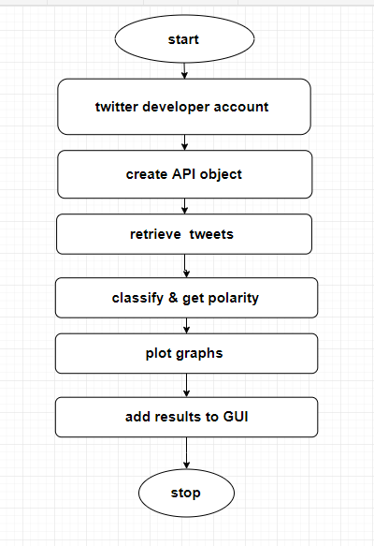

Slide 10
Challenges
• People express opinions in complex ways
• In opinion texts, lexical content alone can be misleading
• Intra-textual and sub-sentential reversals,negation, topic change common
• Rhetorical devices/modes such as sarcasm, irony, implication, etc.
• Unstructured and also non-grammatical
• Lexical Variation
• Out of Vocabulary Words
• Extensive usage of acronyms like asap, lol, afaik

Slide 11
Future scope
Business
Politics
Smartphones
Social issues

Slide 12
Conclusion
Hence we have implemented a simple twitter sentiment analyzer using python dependencies such as textblob and tweepy , in this project we have successfully classified the tweets into positive ,negative and neutral . We have find the average polarity and subjectivity of the particular thread. The two graphs i.e retweet and overall graphs are showed for pictorial analysis Sentiment analysis can also be carried out using other platforms such as facebook and some forums sites .

